Slide 1
Decision Tree Algorithms
Information Gain In order to pick which, feature to split on, we need a way of measuring how good the split is. This is where information gain and entropy come in.

Slide 2
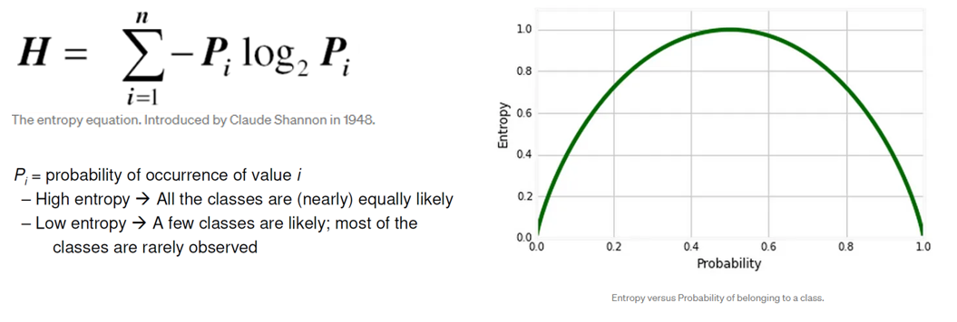
ID3 (Iterative Dichotomize)
Uses Information Theory (Entropy) to split on an attribute that gives the highest information gain
Entropy (Information Theory)
A measure of the impurity of a distribution
Calculation: for a discrete random variable Y taking m distinct values {y1, …, ym}

Slide 3
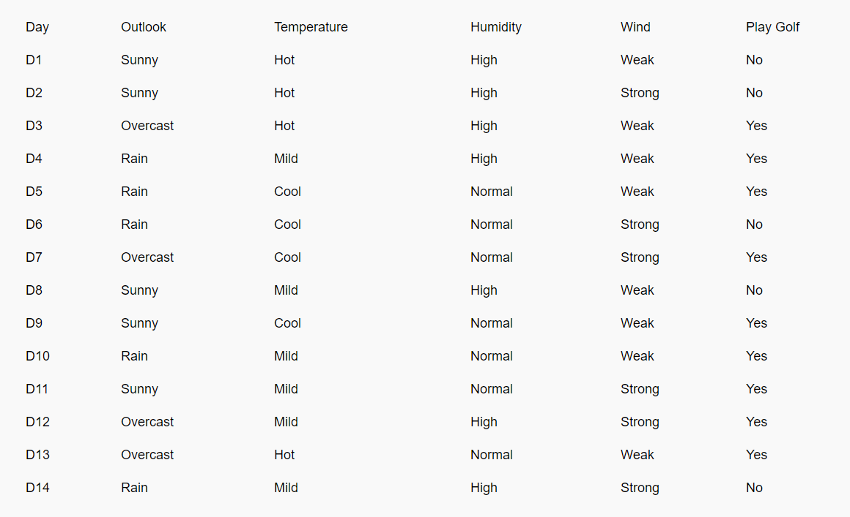

Slide 4
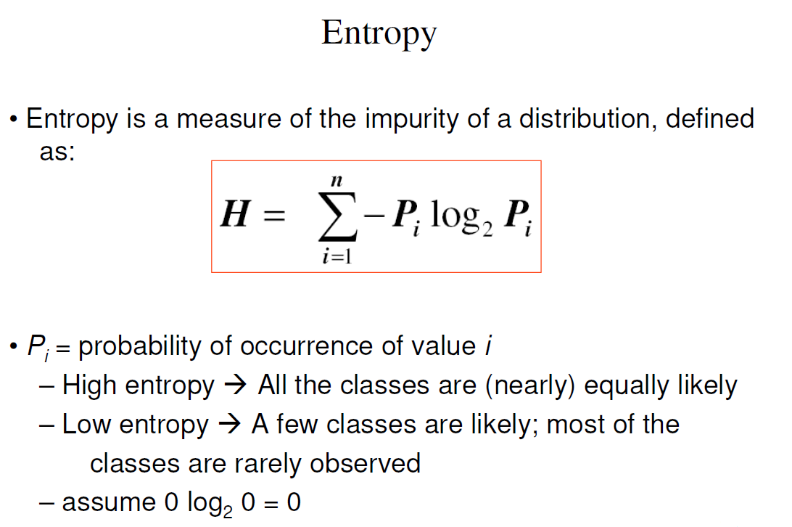

Slide 5
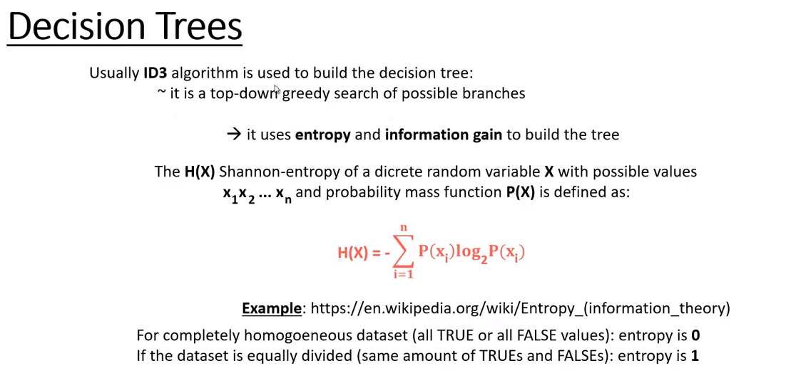

Slide 6
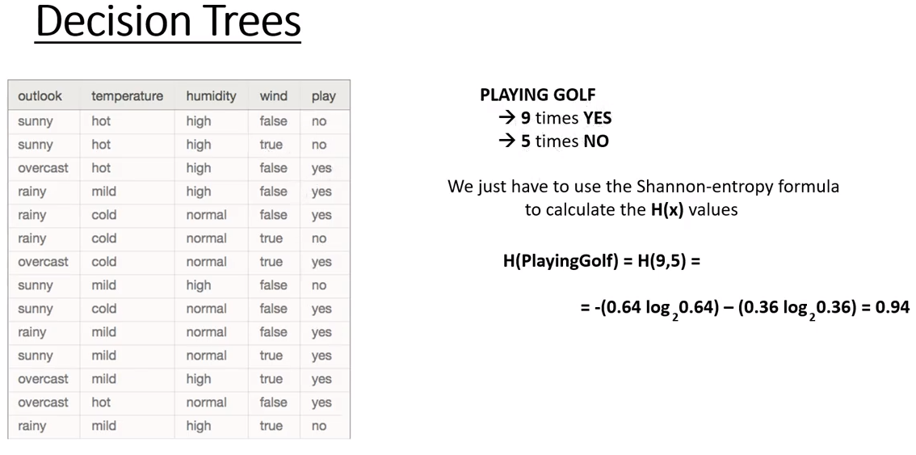

Slide 7
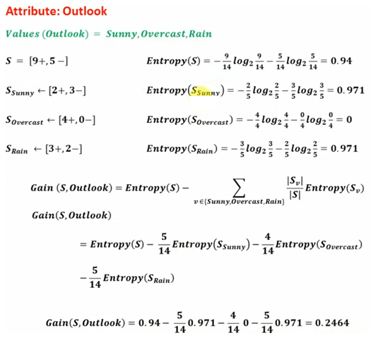
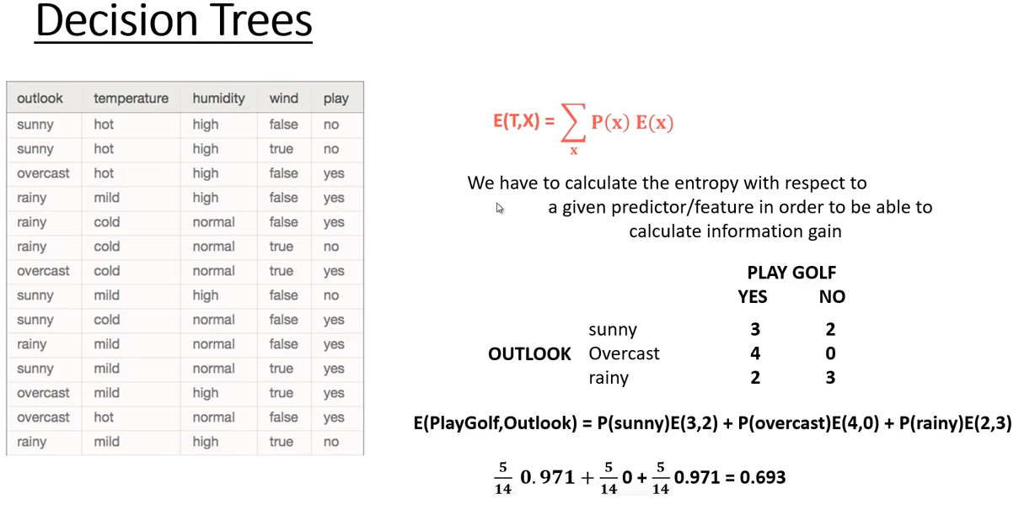

Slide 8
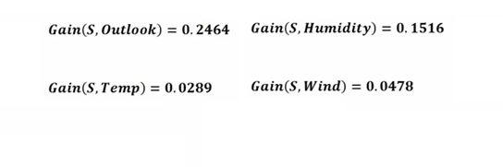
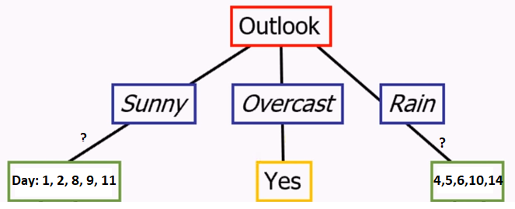

Slide 9

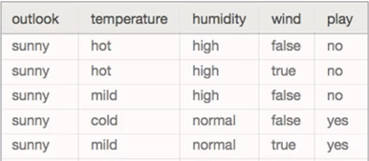
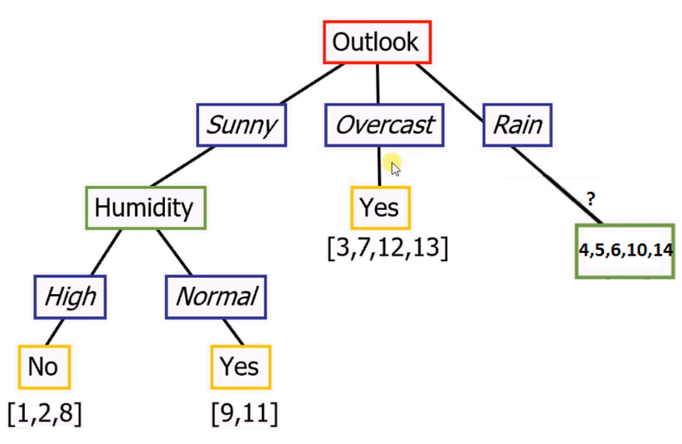
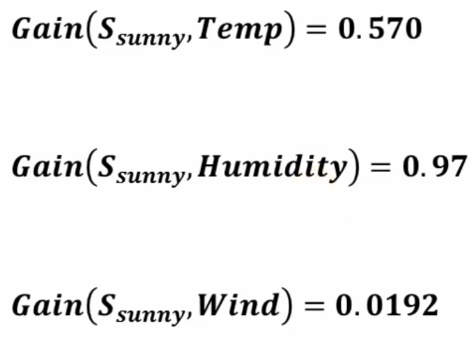

Slide 10
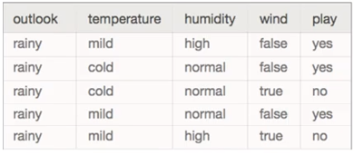
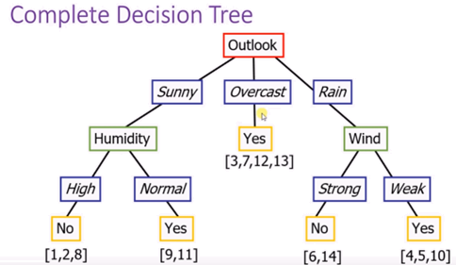
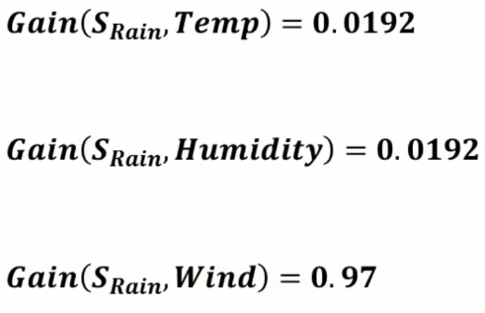

Slide 11
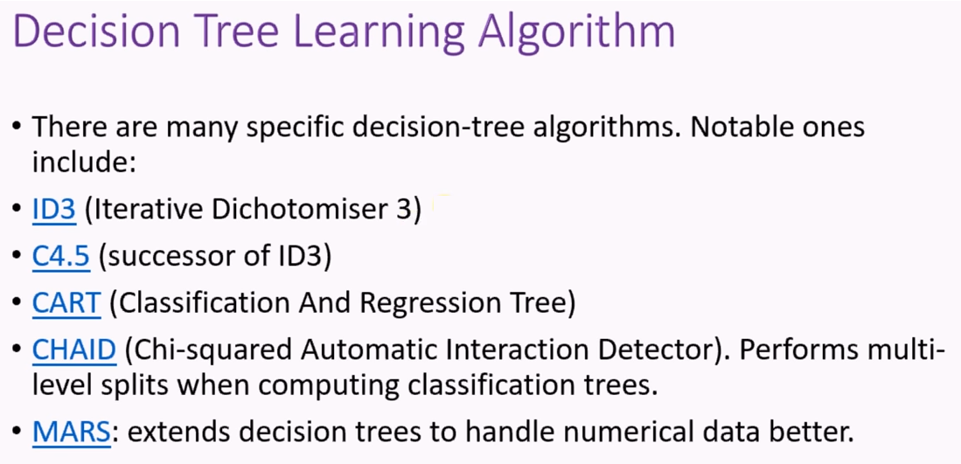

Slide 12
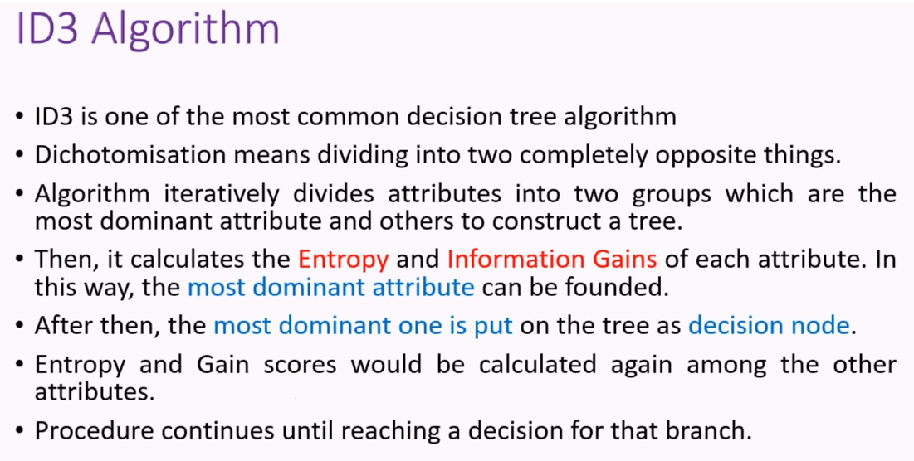

Slide 13
Random Forest is a popular machine learning algorithm that belongs to the family of ensemble methods. It is based on decision trees and combines the predictions of multiple decision trees to improve the accuracy and robustness of the model. The basic idea behind Random Forest is to build many decision trees, each on a different subset of the training data, and then combine their predictions to obtain a final prediction.
The main advantages of Random Forest are its ability to handle large datasets with many features, its robustness to outliers and noisy data, and its ability to estimate the importance of each feature. The main disadvantages of Random Forest are its computational complexity and the difficulty in interpreting the individual trees.

Slide 14
The idea behind a Random Forest is simple:
We repeatedly select data from the data set (with replacement) and build a Decision Tree with each new sample. It is important to note that since we are sampling with replacement, many data points will be repeated, and many won’t be included as well. This is important to keep in mind when we talk about measuring error of a Random Forest. Another important feature of the Random Forest is that each node of the Decision Tree is limited to only considering splits on random subsets of the features.

Slide 15
In the case of classification with Random Forests, we use each tree in our forest to get a prediction, then the label with the most votes becomes the predicted class for that data point.
The usual parameters when building a forest (standard defaults used in the SciKit-Learn library) are 10 trees and only considering the square root of ‘n’ features, where n is the total number of features.

Slide 16
The key features of the Random Forest algorithm are:
Decision Tree: The individual decision trees in a Random Forest are built using the CART (Classification and Regression Trees) algorithm. Each tree is grown independently of the others, using a random subset of the features and a random subset of the training data.
Bagging: Random Forest uses a technique called bagging (bootstrap aggregating) to create the subsets of the training data. Bagging involves sampling the training data with replacement, which means that some observations may appear in multiple subsets, and some may not appear at all.

Slide 17
Randomness: Random Forest introduces randomness into the algorithm in two ways. First, the subsets of the training data and the features used to build each tree are selected randomly. Second, at each node of the tree, a random subset of the features is considered for splitting.
Ensemble: The final prediction of the Random Forest is based on the ensemble of the predictions of the individual trees. In classification problems, the majority vote of the trees is used to make the final prediction. In regression problems, the average of the predictions of the trees is used.

Slide 18
XGBClassifier is a popular machine learning algorithm that belongs to the family of gradient boosting methods. It is based on decision trees and combines the predictions of multiple decision trees to improve the accuracy and robustness of the model.
The basic idea behind XGBClassifier is to build many decision trees sequentially, where each tree corrects the errors of the previous tree.
The main advantages of XGBClassifier are its ability to handle large datasets with many features, its high accuracy, and its efficiency in training and prediction. The main disadvantages of XGBClassifier are its sensitivity to the choice of hyperparameters and its difficulty in interpreting the individual trees.

Slide 19
The key features of the XGBClassifier algorithm are:
Decision Tree: XGBClassifier uses a modified version of the CART (Classification and Regression Trees) algorithm to build decision trees. The modifications include the use of a regularization term to prevent overfitting and the use of a weighted quantile sketch algorithm to efficiently find the optimal split points.
Boosting: XGBClassifier uses a technique called boosting to create the sequence of decision trees. Boosting involves training each tree on a modified version of the training data, where the observations that were misclassified by the previous trees are given more weight.
Gradient Descent: XGBClassifier uses a variant of gradient descent called gradient boosting to minimize the loss function. The loss function measures the difference between the predicted values and the actual values, and the goal is to minimize this difference.

Slide 20
Regularization: XGBClassifier uses two types of regularization to prevent overfitting. The first type is called shrinkage, which involves multiplying the predictions of each tree by a small constant. The second type is called feature subsampling, which involves randomly selecting a subset of the features to consider for each split.
Ensemble: The final prediction of XGBClassifier is based on the ensemble of the predictions of the individual trees. In classification problems, the majority vote of the trees is used to make the final prediction. In regression problems, the average of the predictions of the trees is used.

Slide 21
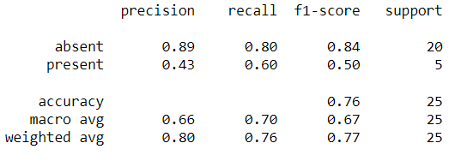
Precision is the proportion of correctly predicted positive observations (i.e., true positives) out of all observations that the model predicted as positive. It can be calculated as: true positives / (true positives + false positives)
Precision measures the accuracy of the positive predictions made by the model. A high precision indicates that the model makes very few false positive predictions.
Recall is the proportion of correctly predicted positive observations (i.e., true positives) out of all actual positive observations. It can be calculated as: true positives / (true positives + false negatives)
Recall measures the ability of the model to identify all positive observations in the test data. A high recall
indicates that the model makes very few false negative predictions.
F1 score is the harmonic mean of precision and recall, and it provides a balanced measure of the two metrics. It can be calculated as: 2 * (precision * recall) / (precision + recall)
F1 score ranges from 0 to 1, where 1 indicates perfect precision and recall, and 0 indicates that the model's predictions are completely wrong.

Slide 22
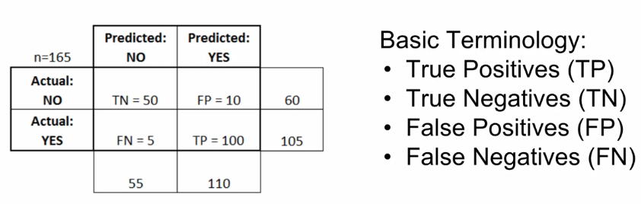
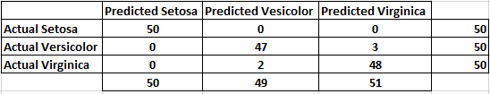
We can use confusion matrix to evaluate performance of our model. A confusion matrix for a binary class such predicting a disease:
A confusion matrix for a multi class data set such as predicting iris flower:

